Slide 1

WAY TO ENTERPRISE
Spring Framework

Slide 2
Agenda
Hello World Spring Data JPA
Spring Data Introduction
Custom Query
Assignments
Copyright © VTI Academy All Rights Reserved

Slide 3
Hello World Spring Data JPA
Step 1: Create Spring Project
Step 2: Config database into application.properties file
Step 3: Create Persistent Object
Step 4: Create interface JpaRepository
Step 5: Create service & controller
Step 6: Start Server
Step 7: Test

Slide 4
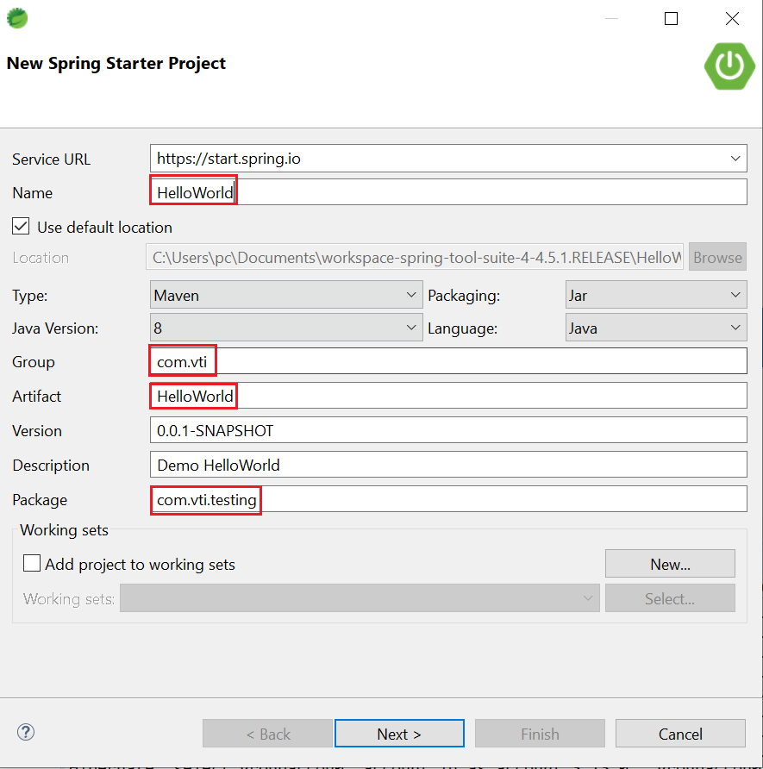
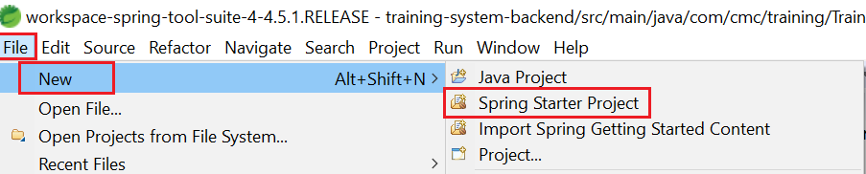
Hello World Spring Data JPA
Step 1: Create Spring Project

Slide 5
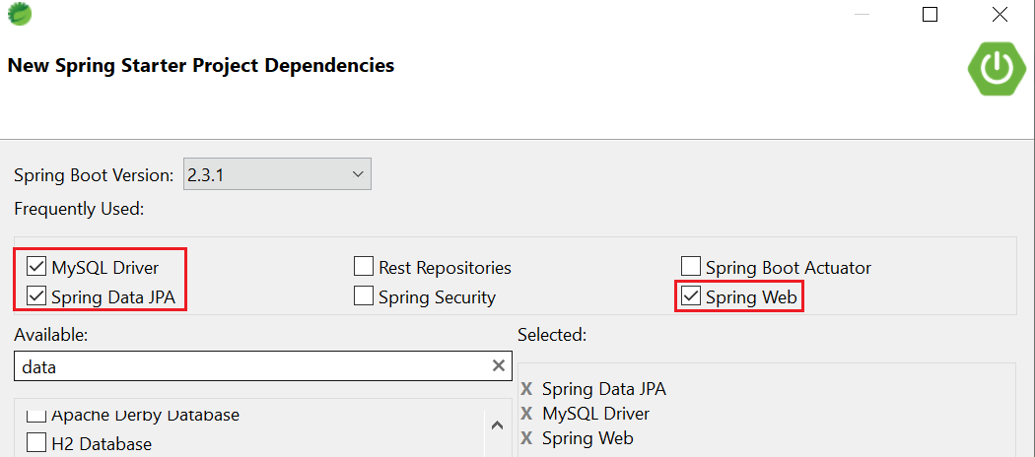
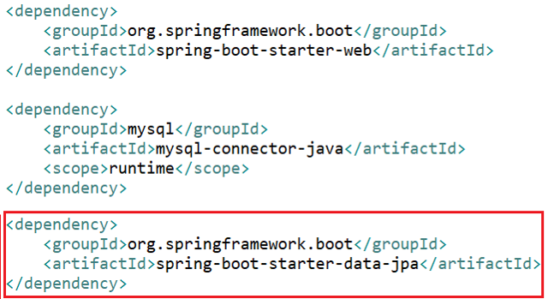
Hello World Spring Data JPA

Slide 6
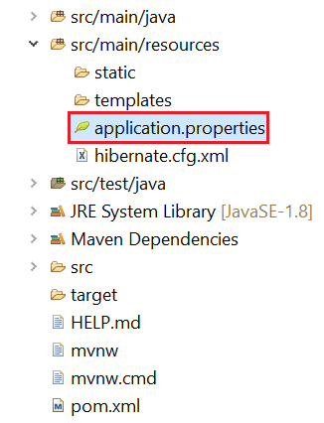
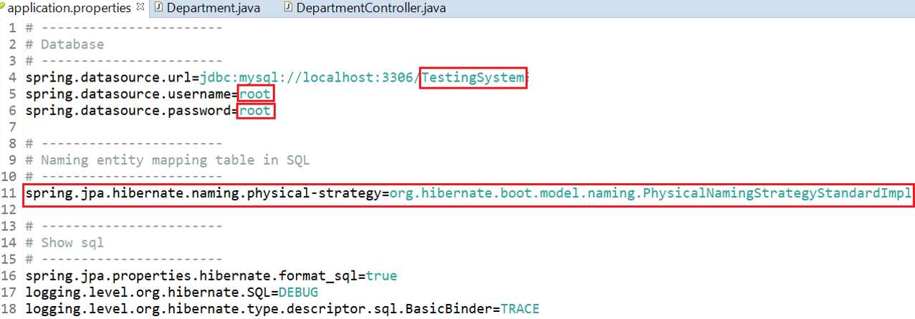
Hello World Spring Data JPA
Step 2: Config database into application.properties file

Slide 7
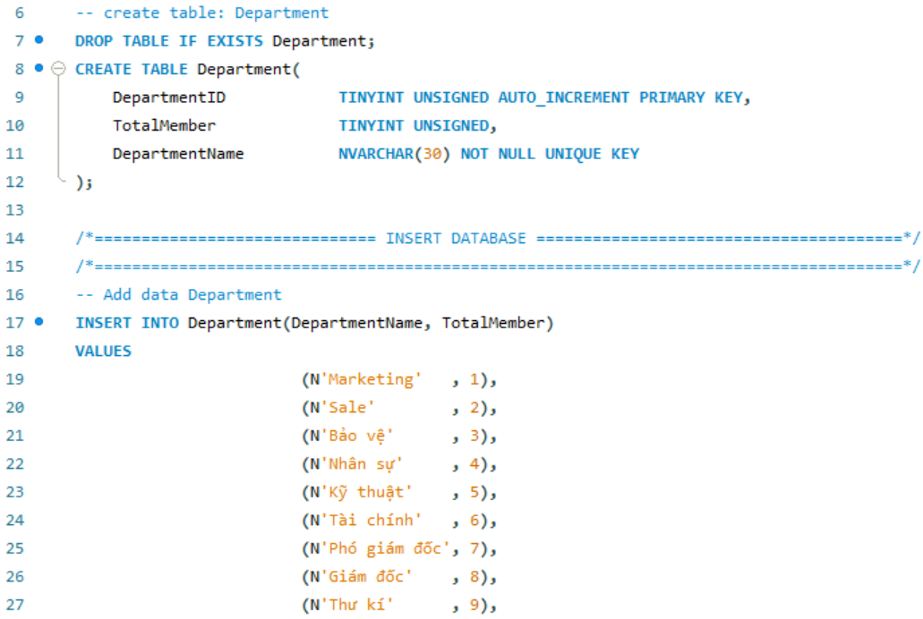
Hello World Spring Data JPA

Slide 8
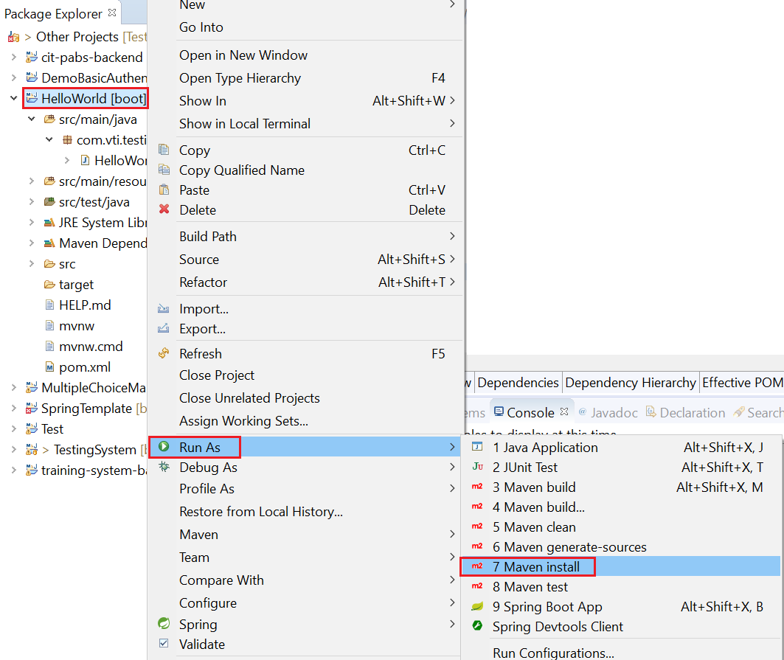
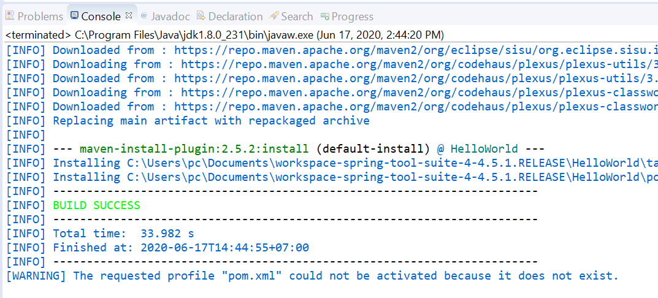
Hello World Spring Data JPA

Slide 9
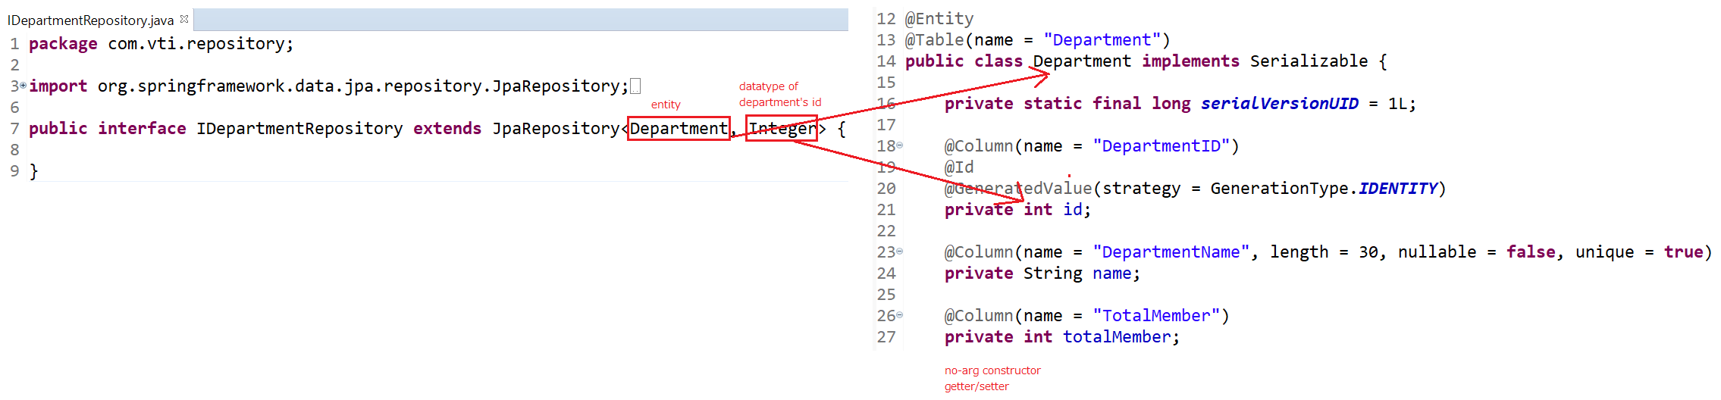
Hello World Spring Data JPA
Step 3: Create Persistent Object
Step 4: Create interface JpaRepository

Slide 10
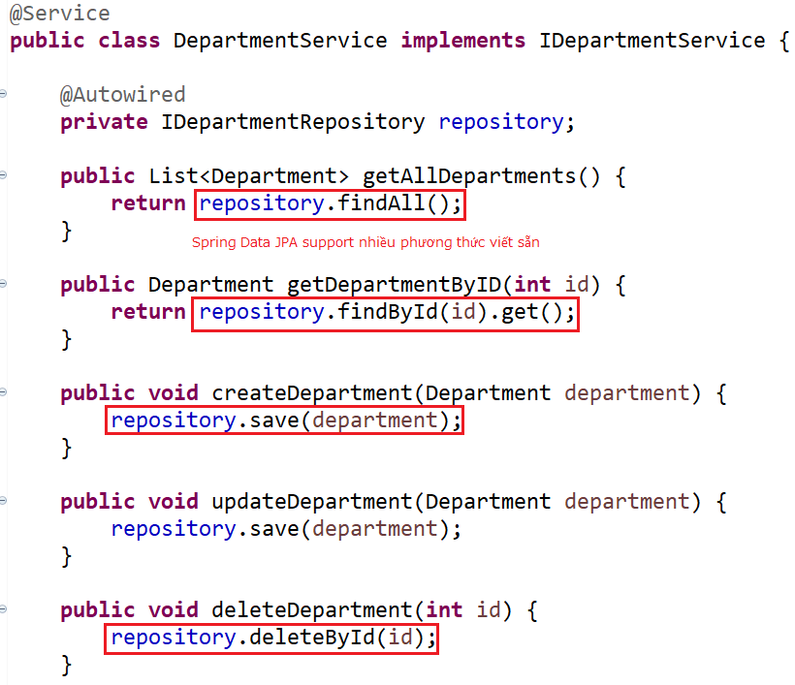
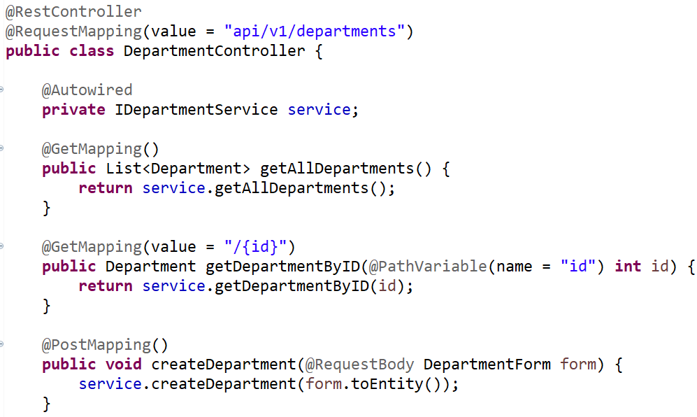
Hello World Spring Data JPA
Step 5: Create service & controller

Slide 11
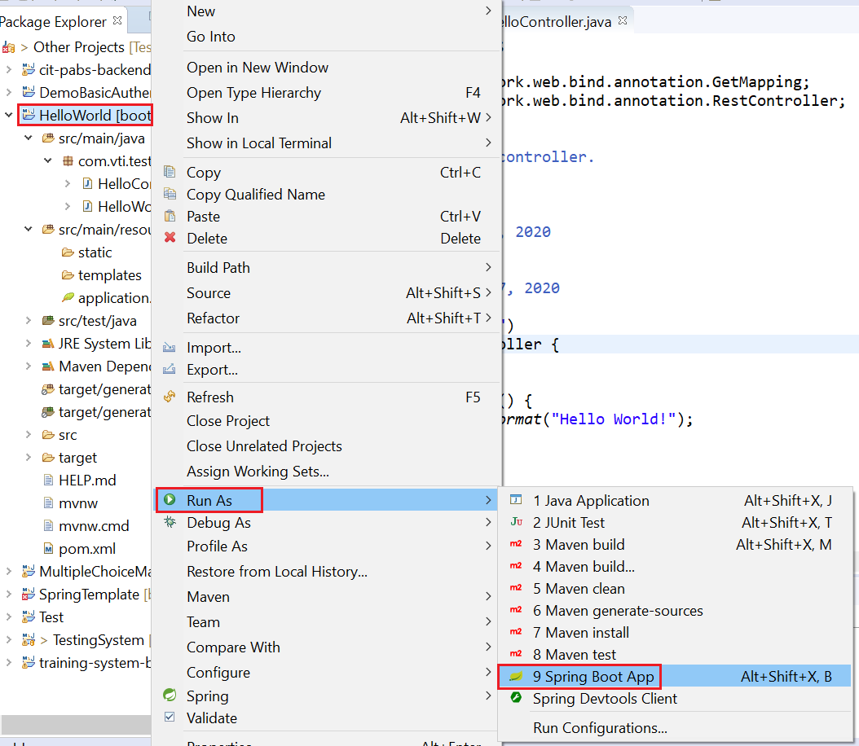
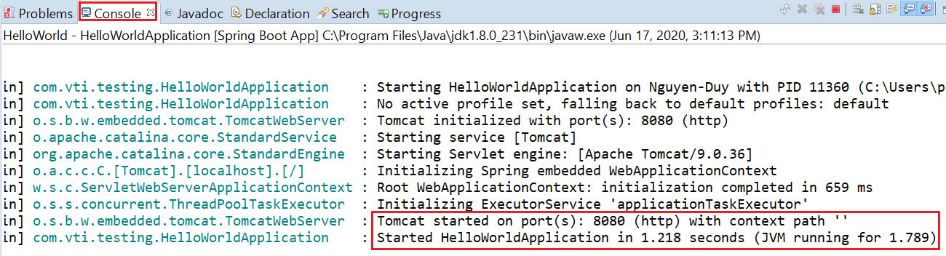
Hello World Spring Data JPA
Step 6: Start Server

Slide 12
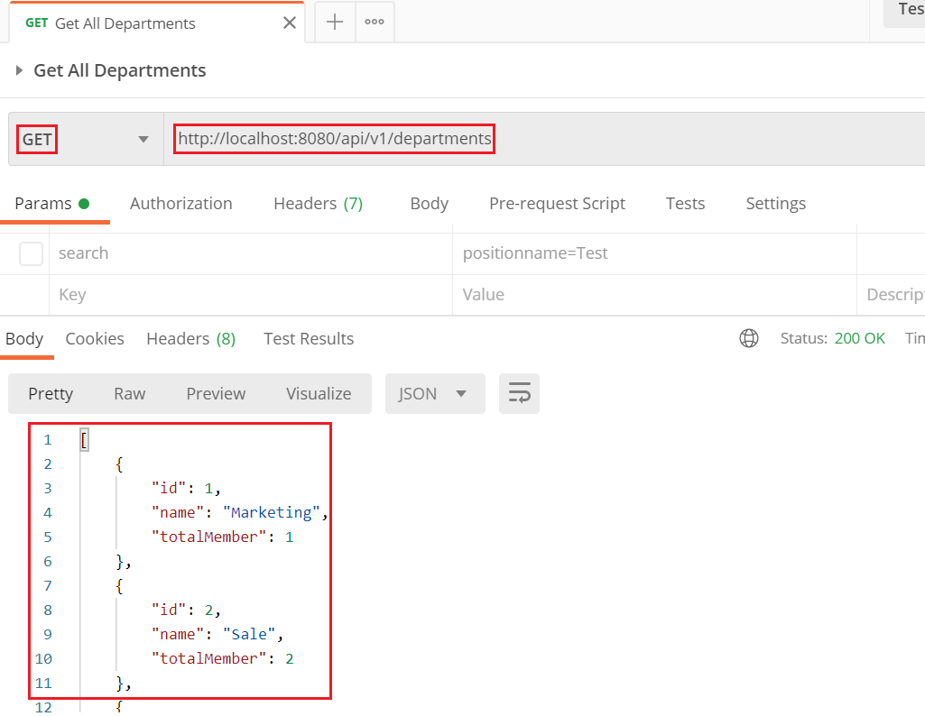
Hello World Spring Data JPA
Step 7: Test

Slide 13
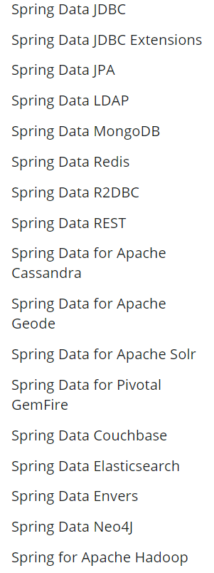
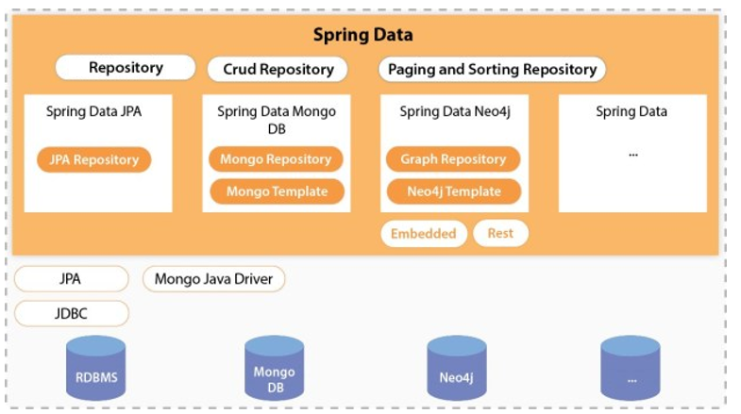
Spring Data
Working with both SQL & NoSQL
Spring Data JPA Generated DAO ➔ No More DAO Implementations
Main tasks
  CRUD (Create, Read, Update, Delete)
  Pagination, Sorting and Filtering
https://spring.io/projects/spring-data

Slide 14
Spring Data
Support multiple features:
  Custom Query
  Paging & Sorting
  Specification (Where)
  Transaction (Next Lesson)
  Spring Data Rest (Next Lesson)

Slide 15
Spring Data
Custom Query
  Method names
  @Query Annotation
  Named Queries (Self-study)

Slide 16
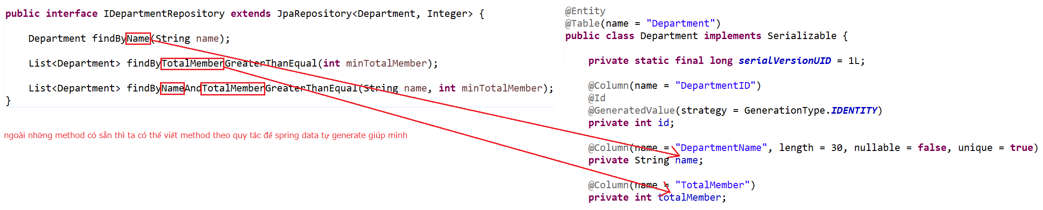
Spring Data
Method names
Repository

Slide 17
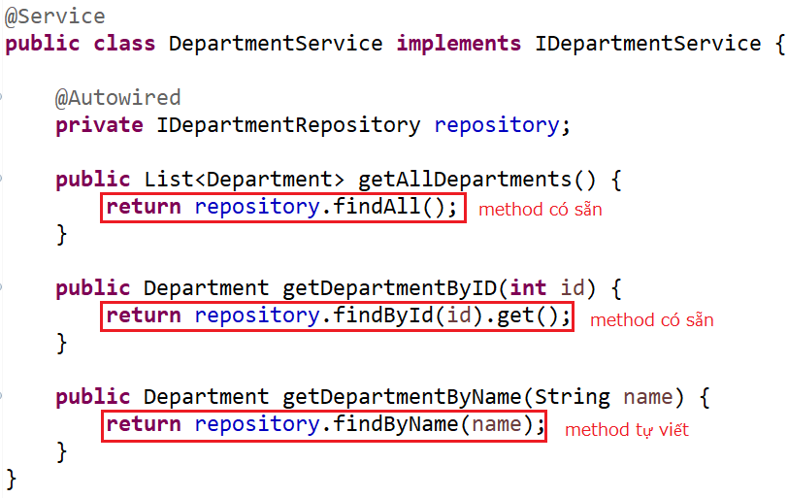
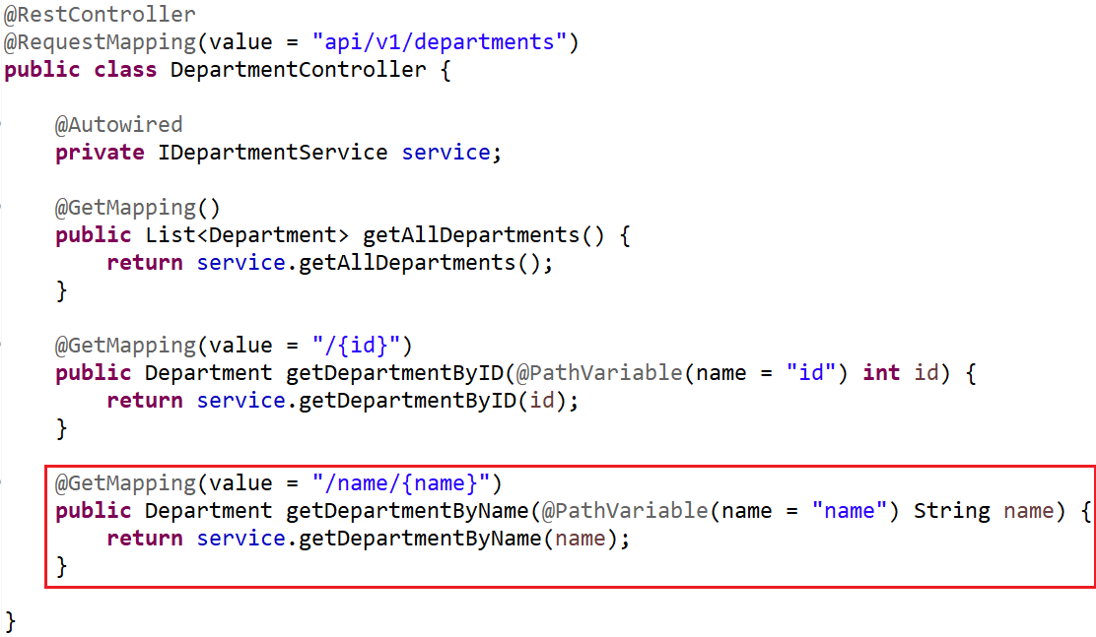
Spring Data
Service & Controller

Slide 18
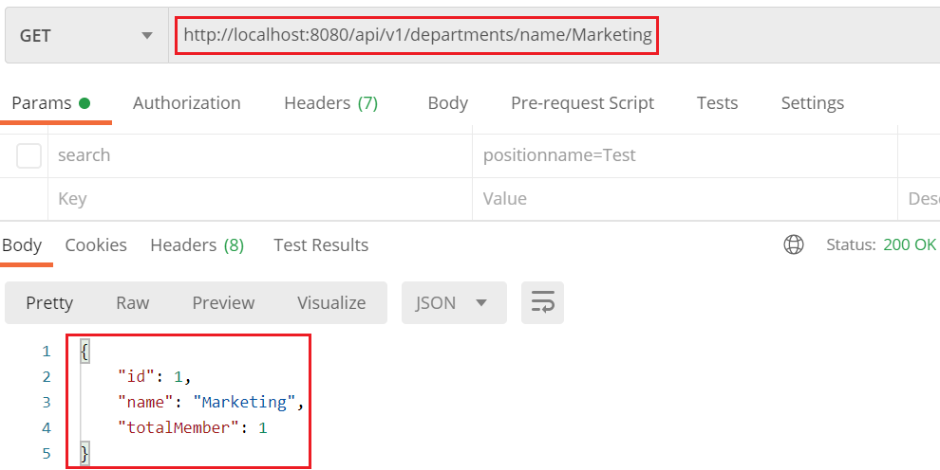
Spring Data
Test

Slide 19
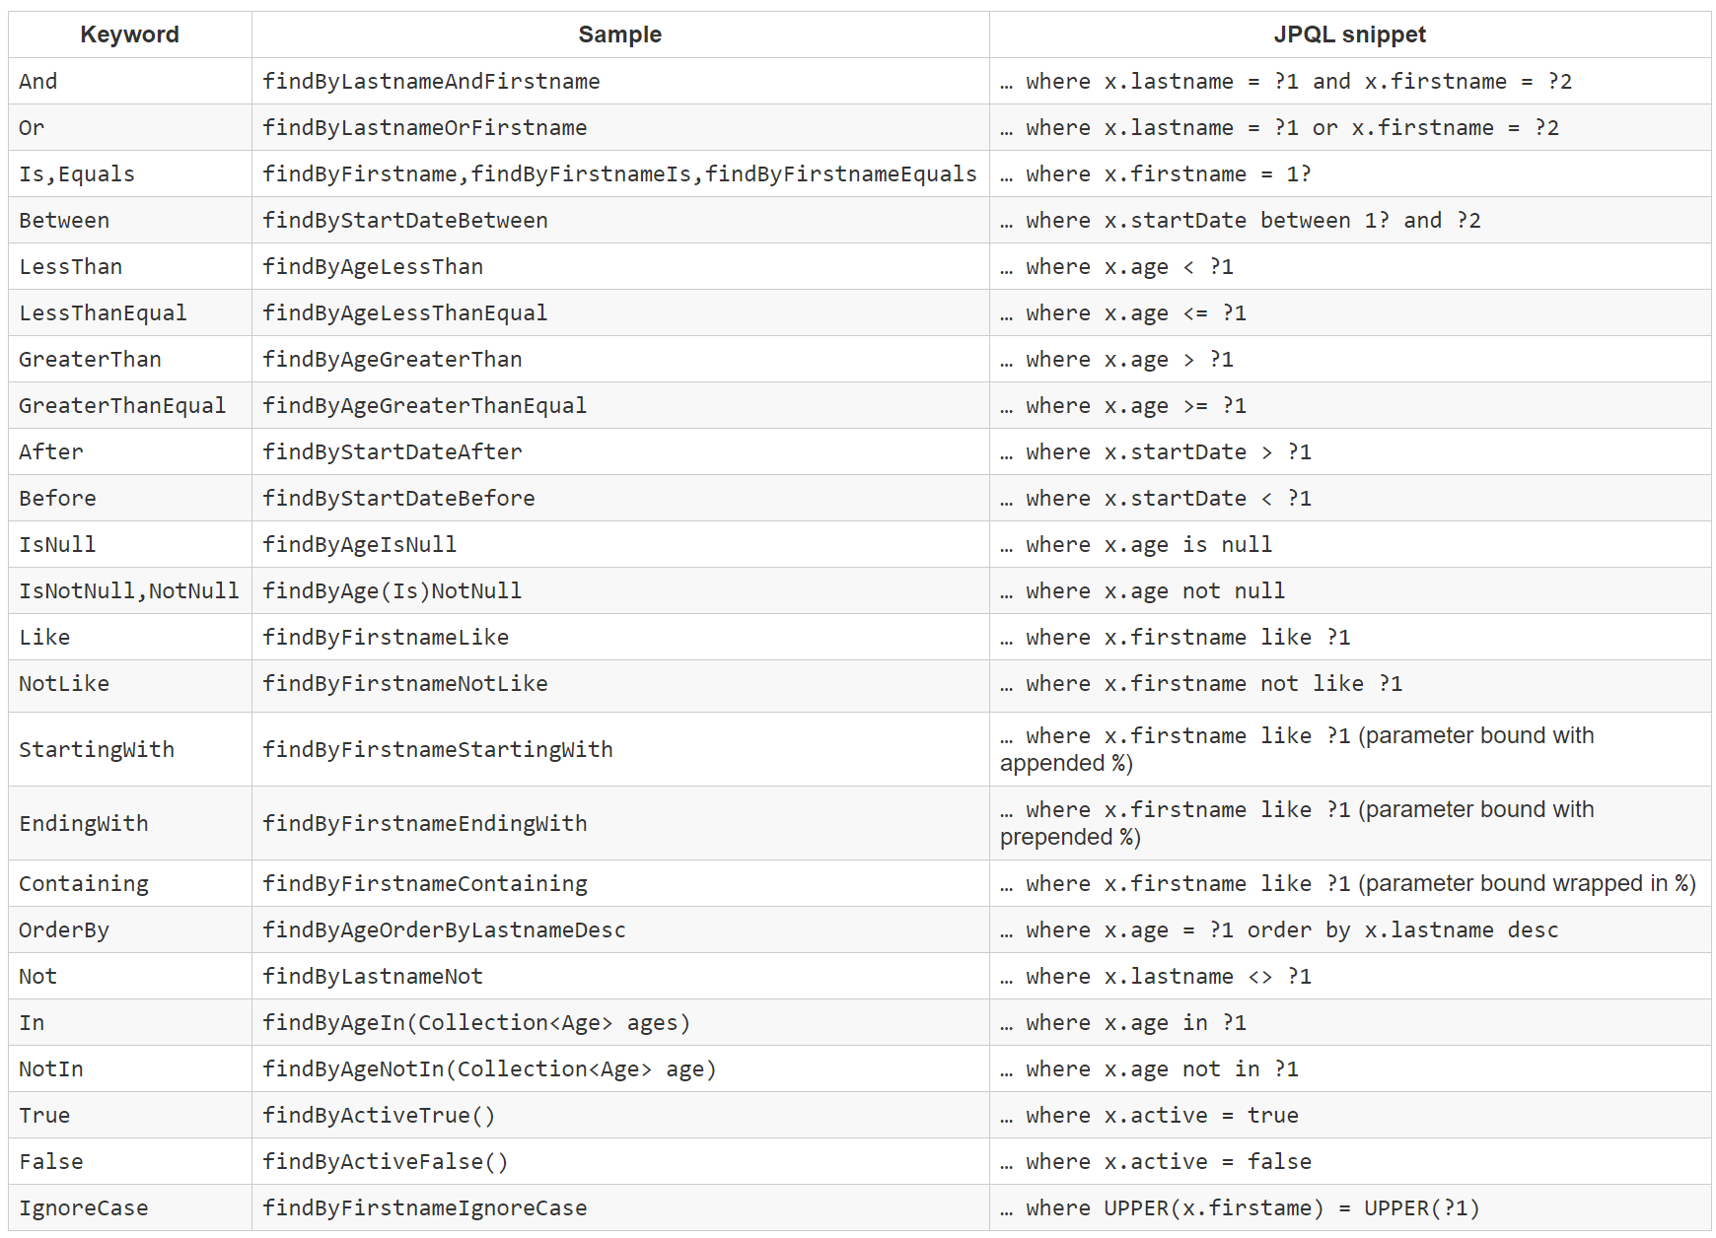
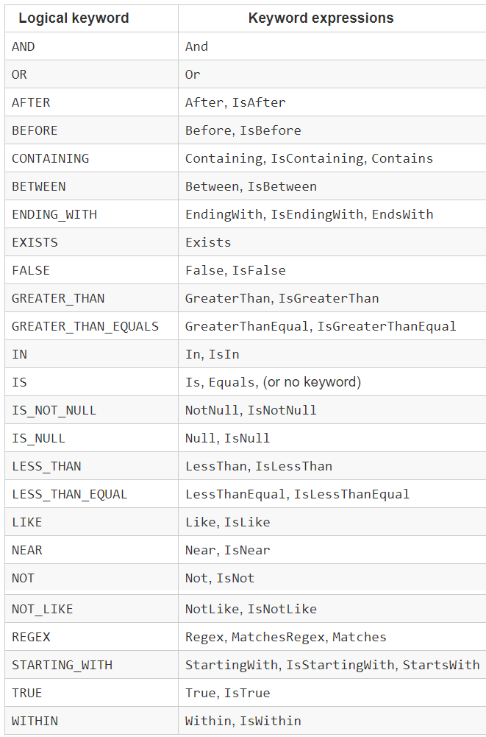
Spring Data
Name Pattern
Operator Pattern

Slide 20
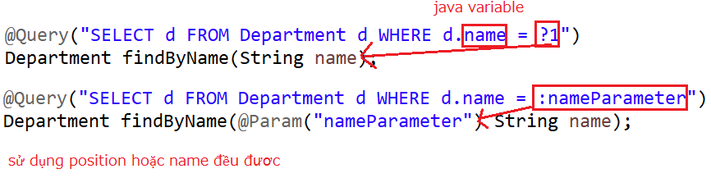
Spring Data
@Query Annotation
HQL
SQL

Slide 21
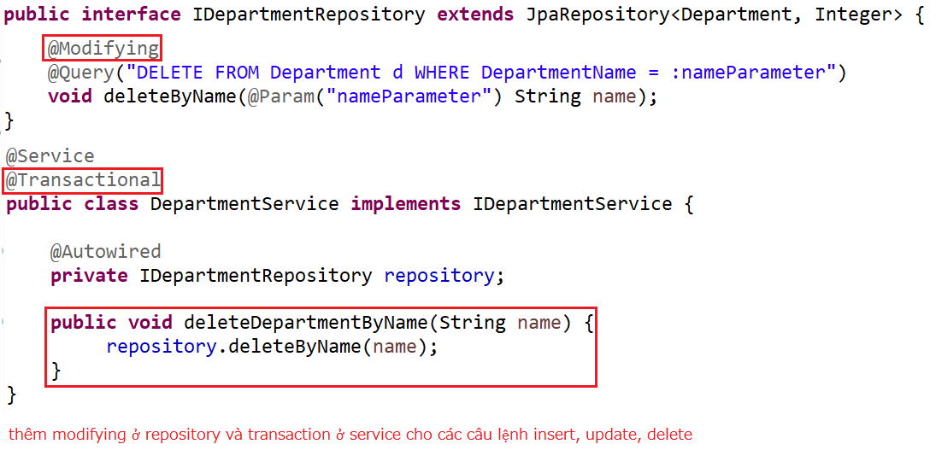
Spring Data
Modifying @Query with Transaction
Repository & Service

Slide 22
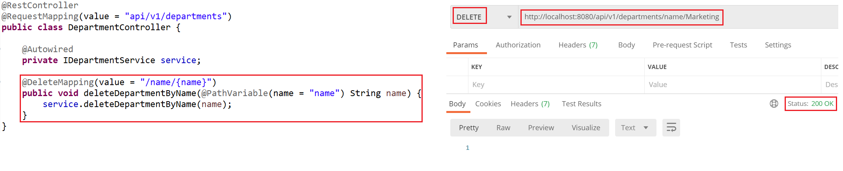
Spring Data
Controller & Test

Slide 23
Spring Data
Named Queries (Self-study)
    https://attacomsian.com/blog/spring-data-jpa-named-queries

Slide 24
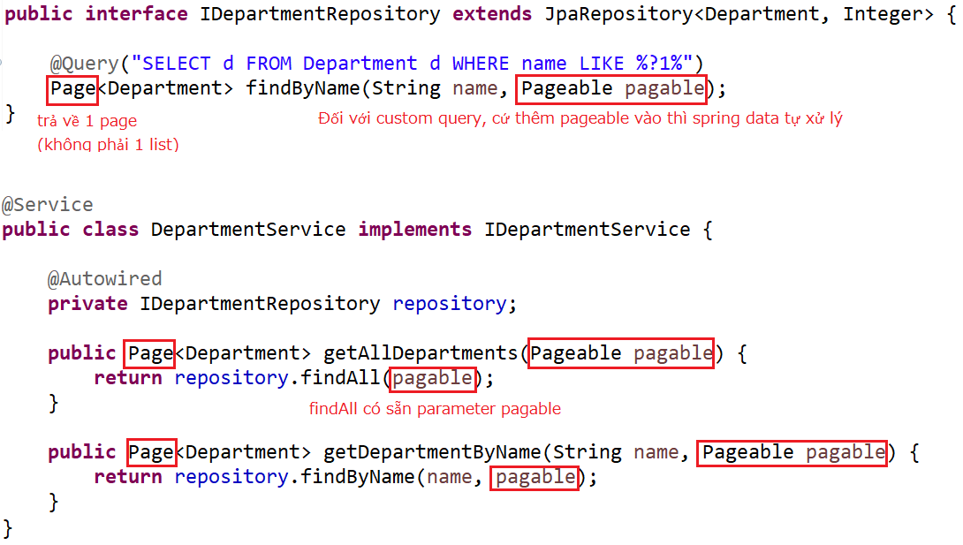
Spring Data
Paging & Sorting
Repository & Service

Slide 25
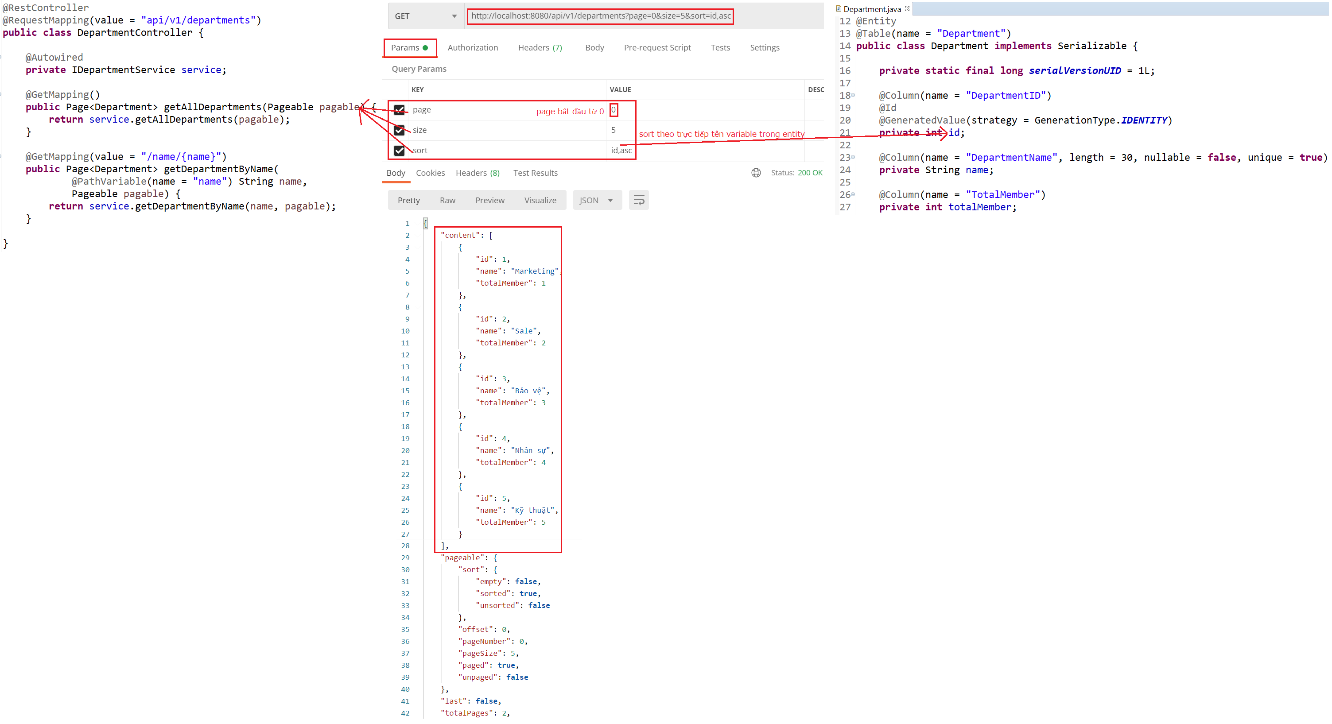
Spring Data
Controller & Test

Slide 26
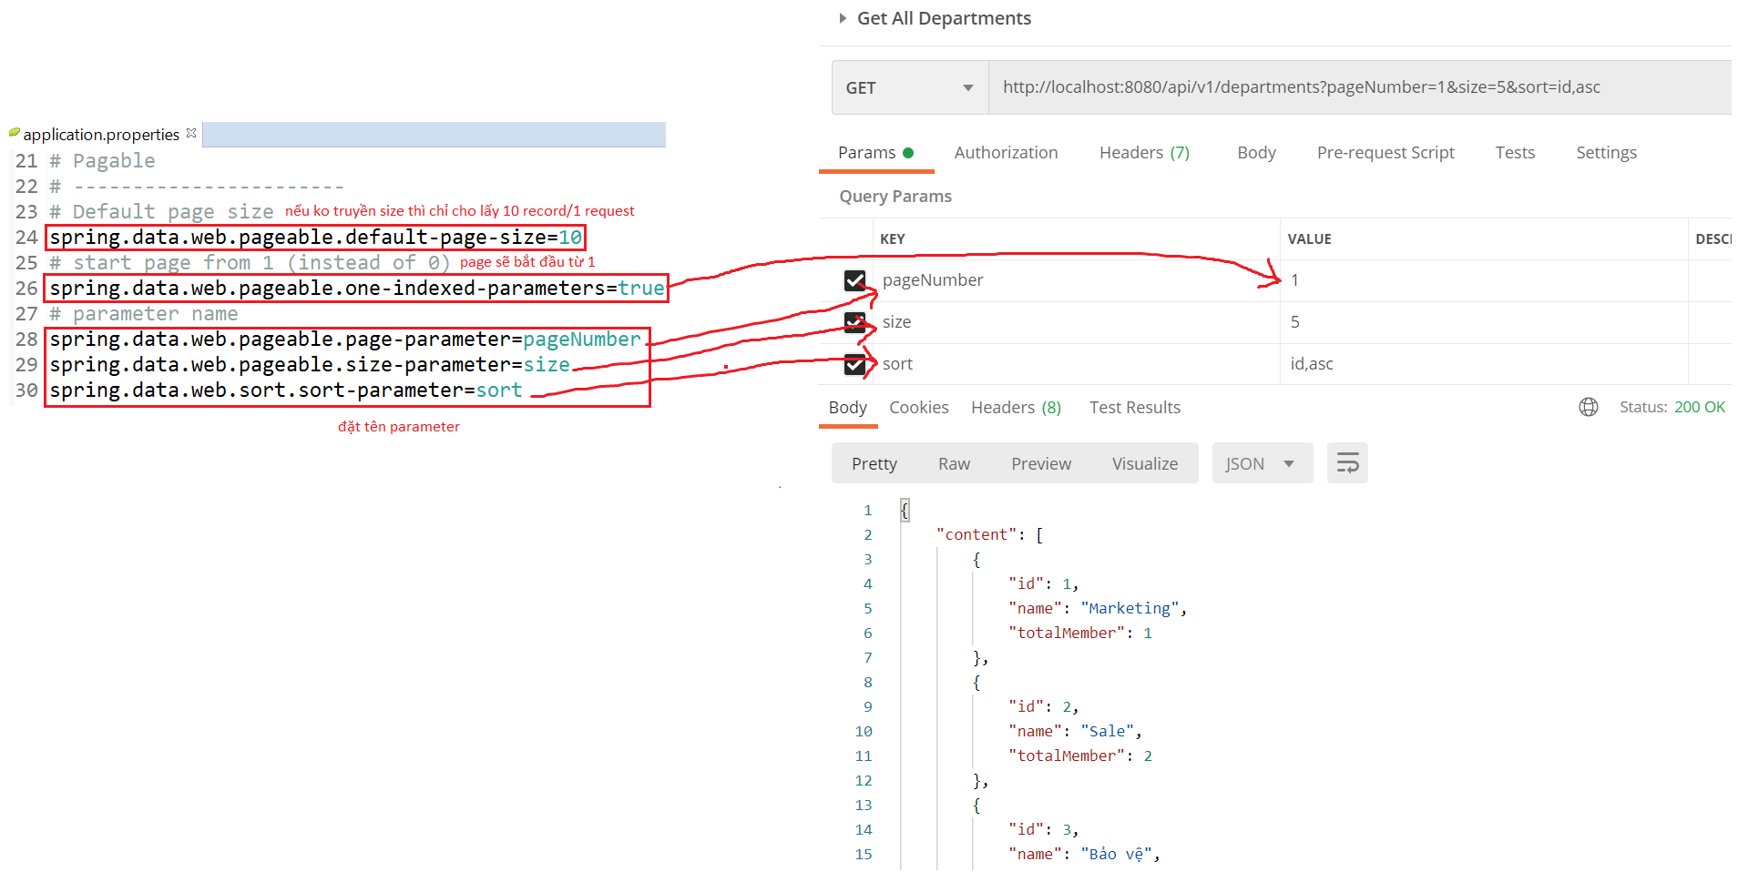
Spring Data
  Config parameter

Slide 27
Reference
https://www.baeldung.com
https://spring.io/projects/spring-boot
https://spring.io/guides#getting-started-guides

Slide 28
Q & A
Copyright © VTI Academy All Rights Reserved

